Slide 1
Live Connect

Slide 2
Live Connect Architecture
Features of Kaseya Live Connect.
Live Connect session
Relay connection establishment
Relay P2P engineering details

Slide 3
Live Connect Features
Provides real-time access
Admin’s machine to remote machine (K Agent)
Fully configurable
File Manager
Drag/Drop file transfer in the browser
Real Time data display of commonly monitored functions. Eg: CPU, Memory.
Scalable
Supports foreign languages.

Slide 4
Live Connect Features(cont.)
Command Shell
Registry Editor
Task Manager
Processes
Services
Performance
Event Viewer
Desktop Access
Notes:
Today on the 5.x platform in order to perform remote troubleshooting many customers use our remote control capabilities to access users machines. Many time the admin cannot remote control in because the user is busy at work.
What we have attempted to do is add remote troubleshooting on agent machine without impacting users.
The Command Shell functionality provides the ability to run commands as if you were sitting at the remote machine.
Registry Editor provides access directly to the remote machines’ registry
View Application, System and Security Events
The Event Log Service records application, security, and system events in Event Viewer. With the event logs in Event Viewer, you can obtain information about your hardware, software, and system components, and monitor security events on a local or remote computer. Event logs can help you identify and diagnose the source of current system problems, or help you predict potential system problems.

Slide 5
Agent Data
Pending Procedures
Agent Logs
Patch Status
Agent Settings
Documents
Get File

Slide 6
Audit Information
Machine Info
Installed Apps
System Info
Disk Volumes
PCI & Disk Hardware
Printers

Slide 7
File Manager
Similar to FileZilla
Two way file transfer
Drag and drop
Supports local volumes only
File functions: move, copy, rename, delete

Slide 8
Command Shell
Similar to CMD.exe
Runs in Service mode
Start in C:\Windows\System32
Supports CMD console commands does not support edit type commands
Agent runs CMD in the background

Slide 9
Registry Editor
Similar to RegEdit
Has search capabilities
Supports 64 bit registries

Slide 10
Task Manager
Processes
Services
Performance
Users
Reboot
User and Groups

Slide 11
Desktop Access
VNC – Available for XP, Vista when users are logged in
RDP - Servers

Slide 12

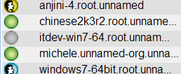
Starting a KLC session
K-Server
Browser
Kaseya Agent
Administrator selects a machine from a list of machines displayed on VSA( Virtual System Administrator)
Live connect session starts in a new browser or a new tab to that machine.
Kserver runs two independent scripts on the Agent with a unique sessionID: runKLCHostDll and runKLCRelayDll
Browser/Admin machine
Agent Machine

Slide 13

Relay connection establishment
KServer
Agent
LiveConnect Relay
( ActiveX control)
KLCHostDll
LiveConnectRelayDll
DllLiveConnectHost listens for connections from far end on a designated port.
LiveConnectRelayDLL pings DllLiveConnectHost on a list of ports and connects with one on which it receives a valid reply( same sessionID)
LiveConnectRelay on the browser machine connects itself to the agent.
Browser/Admin machine
Agent Machine

Slide 14
Loading Modules
KServer
Agent
LiveConnect Relay
( ActiveX control)
LiveConnectHostDll
LiveConnectRelayDll
FileManager
Registry Editor
Command Shell
…
TP
FileManagerDll
Each module will try to load itself using MessageProtocol appInfoMessages. Eg File Manager sends an appInfoMessage to LiveConnectHostDll.
LiveConnectHostDll loads FileManagerDll if not already loaded.
Build a handler serverMessageHandler, and runs this handler on a thread from a thread pool
Browser/Admin machine
Agent Machine

Slide 15
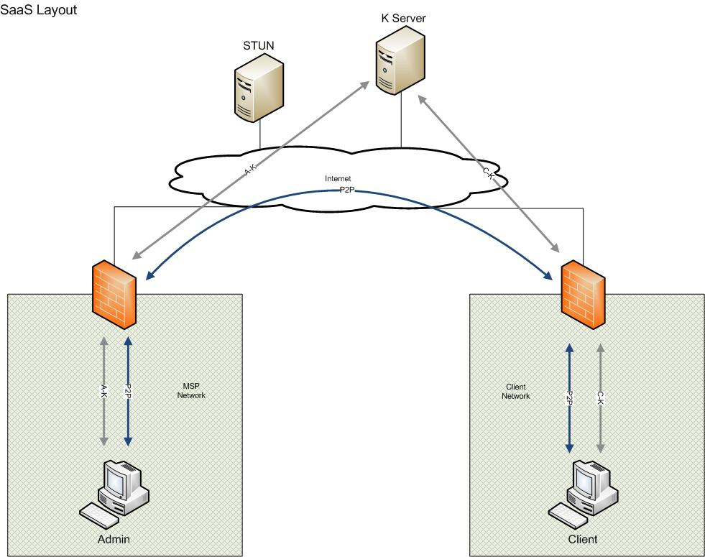
Need for P2P
Scalable approach for remote access is to eliminate going through the server for any real time information. Selecting any action requiring direction access to the remote agent should automatically establishesa peer-to-peer connection from the admin's machine to the agent's machine.
The STUN server allows clients to find out their public address, the type of NAT they are behind and the internet side port associated by the NAT with a particular local port.
.

Slide 16
Establishing P2P connection
Sec Stun Server
KServer
Primary Stun server
Rendezevous Msg
Agent
RouteFinder
LiveConnectRelay
LiveConnectHostDll
LiveConnectRelayDll
Firewall manager in the LiveConnectRelay calls RouteFinder which returns a pair of public and private IPAddress.
RouteFinder queries the Primary and Secondary stun server as well as UPNP device if it discovers one. It then selects the best pair of public/private IPAddress based on connectivity.
Both sides advertise their public/private IPAddress via the relay connection already established, these messages are called Rendezvous message.

Slide 17
Establishing P2P connection
KServer
Agent
Udt/udp connection
LiveConnectRelay
LiveConnectHostDll
LiveConnectRelayDll
FileManager
Registry Editor
…
Command Shell
Agent and Browser try to establish a connection via the IPAddress advertised in the rendezvous message, until they have established a connection.
Once P2P is established, initial relay connection is terminated.
Note that this change in connection is invisible to KLC modules.

Slide 18
Establishing P2P event chronology
TIME P1NAT RELAY P1 STUN P2 P2NAT

Slide 19
P2P SaaS

Slide 20
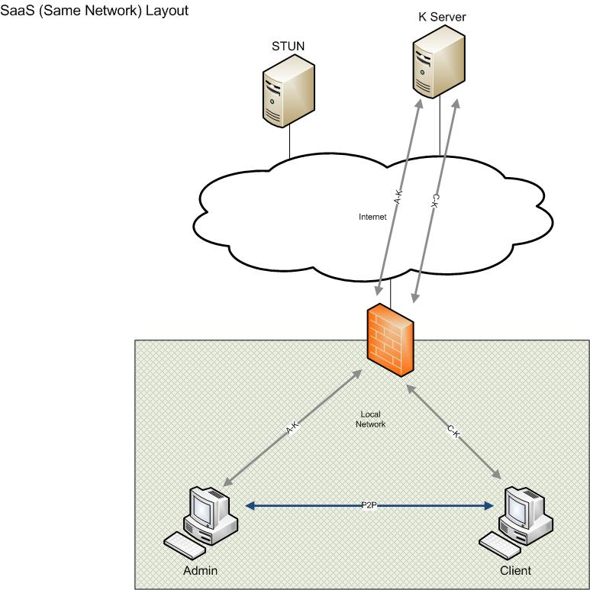
P2P SaaS (con’t)

Slide 21
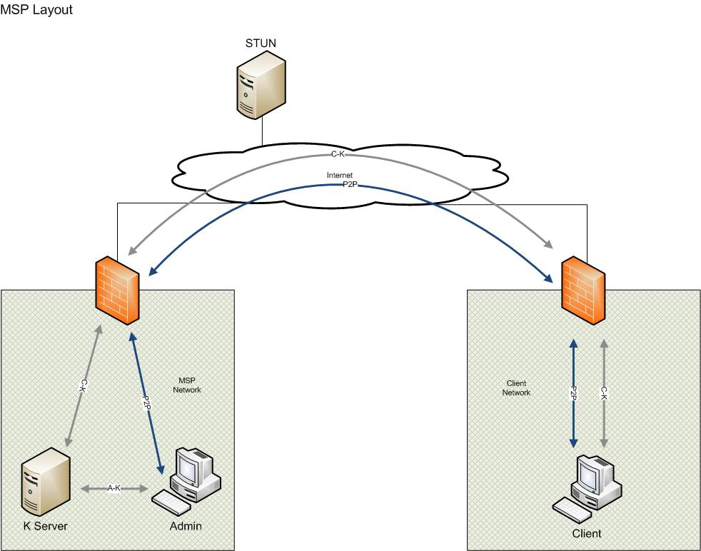
P2P MSP

Slide 22
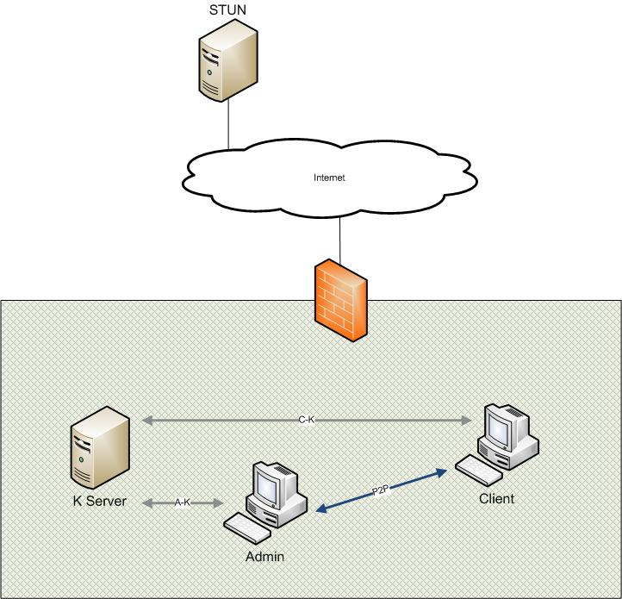
P2P Private

Slide 23
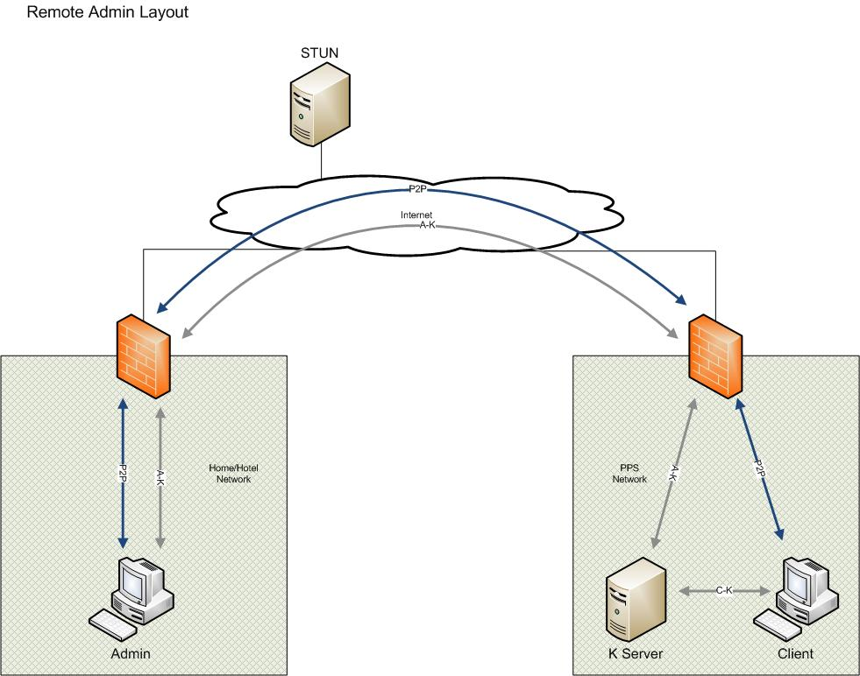
P2P Remote Admin

Slide 24
P2P Heuristics
Heuristics for 'best' public IP (applied in this order) used by the P2P RouteFinder 1. IP is the primary stun server reported public IP AND also matches a router reported public IP 2. IP is the secondary stun server reported public IP AND also matches a router reported public IP 3. IP is the primary stun server reported public IP (AND does not match any router reported public IP)

Slide 25
P2P Heuristics (con’t)
4. IP is the secondary stun server reported public IP (AND not able to reach primary stun server AND does not match any router reported public IP) 5. IP is a router reported public IP (AND not able to reach primary or secondary stun server) 6. IP is the local private address (AND not able to reach primary or secondary stun server AND didn't find any routers)

Slide 26
Diagnostics
TRACE
Audit Files (agent install directory)
Service Log files (agent install dir)
Application event log (event viewer)
Control (AX/NP) log files (alt link)
P2P/Relay status (alt link)
Kaseya Scripts (vsa script logs)

Slide 27
Diagnostics (con’t)
ActiveX Controls
Check for conflict directories:
C:\WINDOWS\Downloaded Program Files\conflict..
Check security level
Check disable controls: IE/Tools/Manage Add-ons
Firefox Add-ons
So far so good

Slide 28
Diagnostics
P2P/Relay
Check P2P/Relay status alt-link
Check KServer relay port
Check for local port conflict (trace log)
Check Agent Scripts
Check selected interface for P2P/Relay

Slide 29
Live Connect Overview
What follows v1?
OS X support
Safari
Kaseya remote control protocol
Updated chat
VoIP
Admin to remote meeting capabilities
Add/Remove Programs
Sound, Remote Printing

